Slide 1
Patterns and Best Practices with Fabric CI/CD

Slide 2
Session Agenda
Essential Concepts and Capabilities
Planning the Fabric CI/CD Project Lifecycle
Creating Project Infrastructure using Terraform
Building a Development Process
Building a Release Process

Slide 3
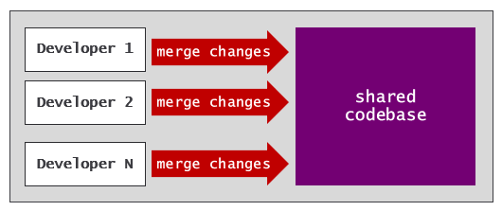
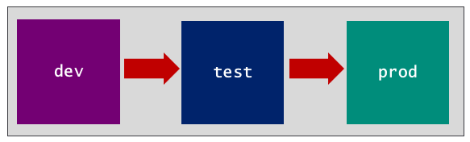
Motivation for CI/CD
What is CI/CD?
Continuous Integration (CI) is practice of frequently merging code changes to shared repository
Continuous Deployment (CD) is practice of automating deployment to target environments
CI provides development process where multiple folks work on same codebase
CD provides release process to move changes through a set of environments

Slide 4
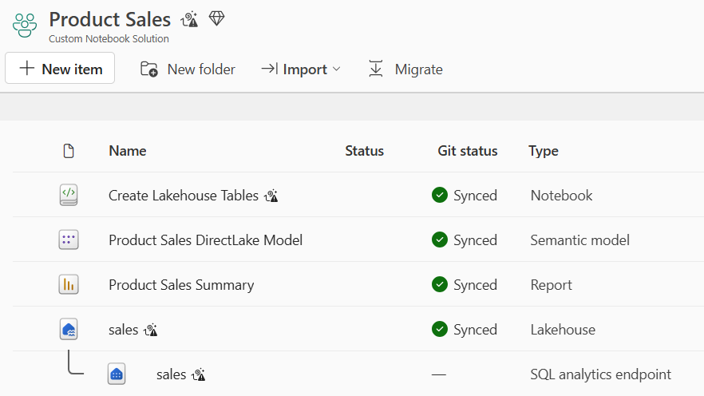
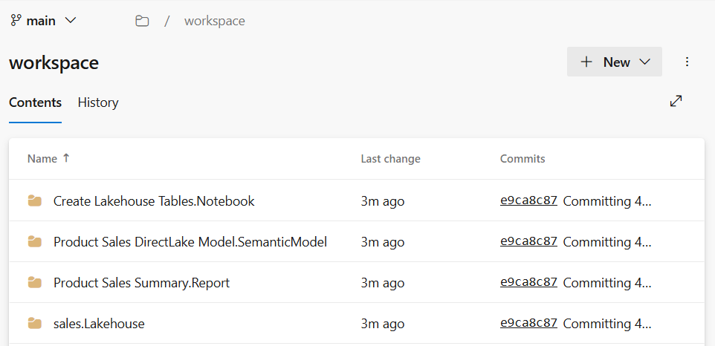
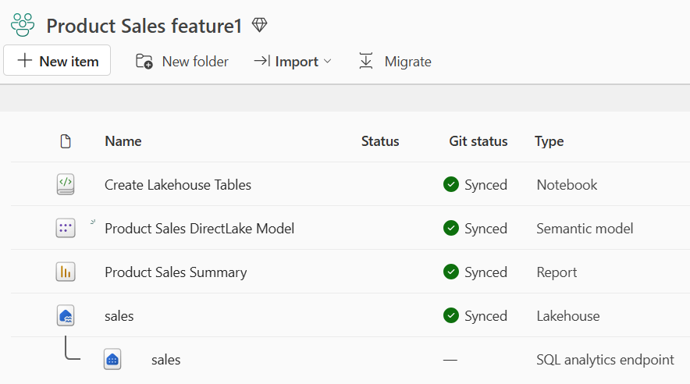
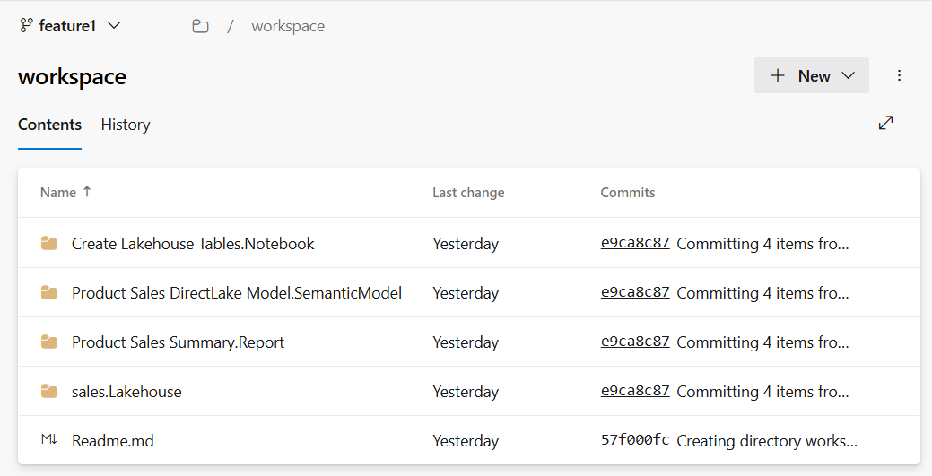
Serialization of Workspace Items to/from Item Definitions
When you connect workspace to GIT branch…
Fabric GIT integration serializes workspace item definitions and writes definition files to branch
Fabric GIT integration can create/update workspace items from item definitions in GIT branch
Commit to GIT
Update from GIT

Slide 5
Automation in Fabric
Tools and libraries to simplify interacting with the Fabric REST APIs
Terraform - IoC tool used to create project infrastructure
Fabric CLI - scripting and interactive tool that promotes ease-of-use experience
.NET SDK - productivity layer on Fabric REST APIs for C# developers
Python SDK - productivity layer on Fabric REST APIs for Python developers
fabric-cicd - Python library used to build release process
Terraform
Fabric CLI
.NET SDK
Python SDK
fabric-cicd
Fabric REST APIs

Slide 6
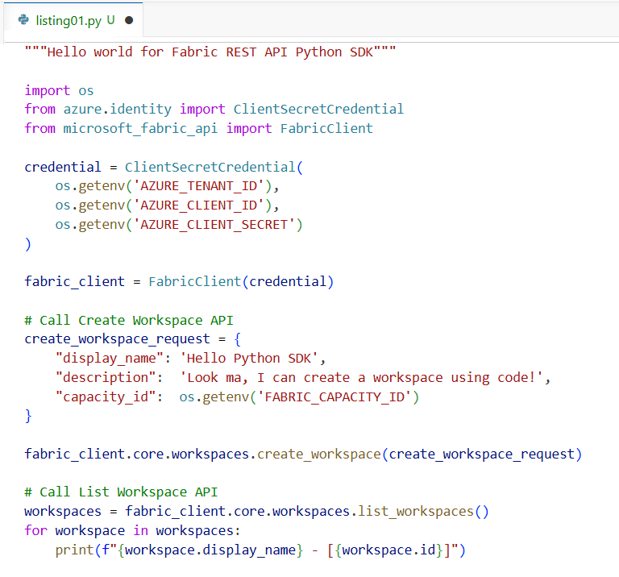
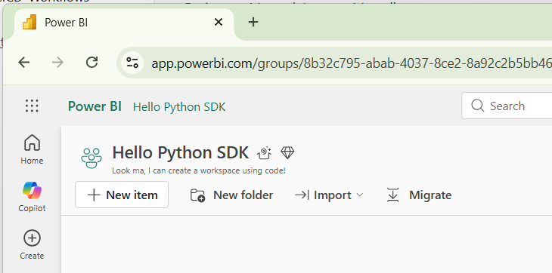
Python SDK (new)
> pip install microsoft-fabric-api

Slide 7
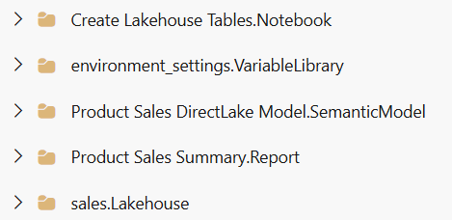
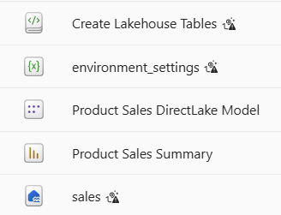
The fabric-cicd Python Library
fabric-cicd library provides code-first deployment strategy for Fabric solutions
Provides built-in code for deploying Fabric solutions and building release processes
Deploys Fabric solution from item definitions folder to set of workspace items in target workspace
Eliminates developers need to program directly with Fabric REST APIs or item definitions
Recently extended with support for configuration-based deployment
An open source project that is fully supported by the Fabric product team
Folder with Item Definitions
target workspace
fabric-cicd processing
Deploy

Slide 8
Fabric CI/CD Best Practices Discussed In This Session
Use service principals for automation
Use Terraform to provision Fabric CI/CD environment infrastructure
Use variable libraries to parameterize settings that change across environments
Abstract logic for ETL jobs into workspace items such as notebooks and pipelines
Write automation scripts to run ETL jobs as an essential aspect of the CI/CD lifecycle
Build a development process based on feature workspaces and pull requests
Develop workflows to automate syncing workspace items from GIT branch
Develop workflows to automate continuous deployment using fabric-cicd library

Slide 9
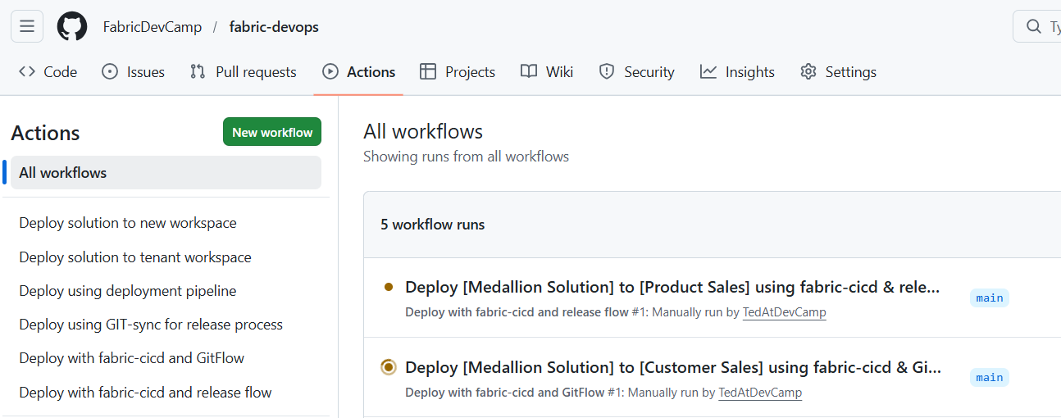
fabric_devops developer sample
Sample project as accessible as public GitHub repository
Provides sample code for setting up Fabric CI/CD projects with end-to-end lifecycle workflow
Automates setting up Fabric CI/CD projects using GitHub workflow actions
Leverages fabric-cicd library for deploying Fabric solutions
Includes support for creating & configuring repositories in Azure Dev Ops and GitHub
GitHub repo at https://github.com/FabricDevCamp/fabric-devops

Slide 10
Planning the Fabric CI/CD Project Lifecycle

Slide 11
Planning the Fabric CI/CD Project Lifecycles
Steps in the planning process
Plan the Fabric solution
Plan the project environments
Plan the GIT repository
Plan the development process (CI)
Plan the release process (CD)

Slide 12
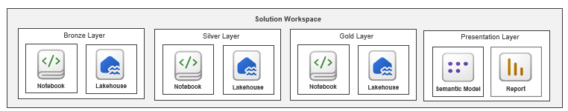
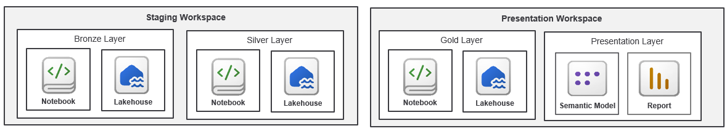
Plan the Fabric Solution
Plan and prototype the Fabric solution
Fabric solution is composed on Fabric items
Fabric solution usually includes workspace items which run ETL logic
Fabric solution can be designed to run in a single workspace
Fabric solution can be spread across multiple workspaces

Slide 13

Plan the Project Environments
Fabric CI/CD project requires multiple environments such as dev, test and prod
Each environment requires workspace(s) to run its own instance of the Fabric solution
Each environment requires Fabric capacity to run it workspace(s)
Each environment might require its own Azure resources such as a storage account or key vault
Each environment has unique environment-specific settings for things like datasource URLs
You must determine which environment-specific settings require parameterization
dev environment
test environment
prod environment
Fabric Workspace
Fabric Workspace
Fabric Workspace
Fabric connection
Fabric connection
Fabric connection
dev ADLS container
test ADLS container
prod ADLS container

Slide 14
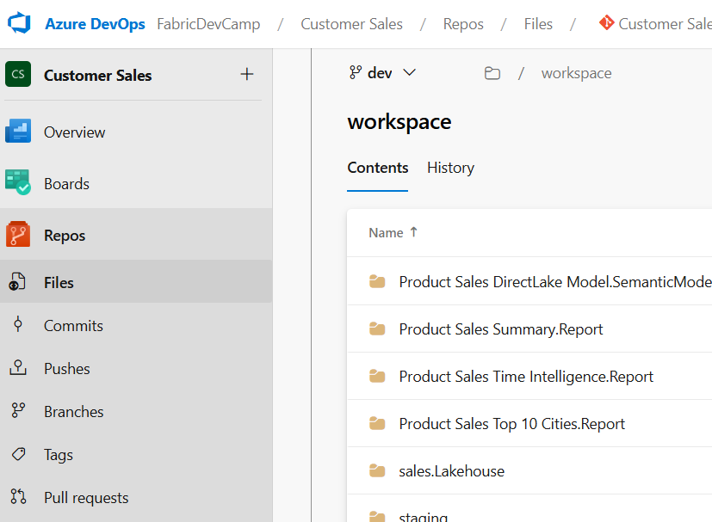
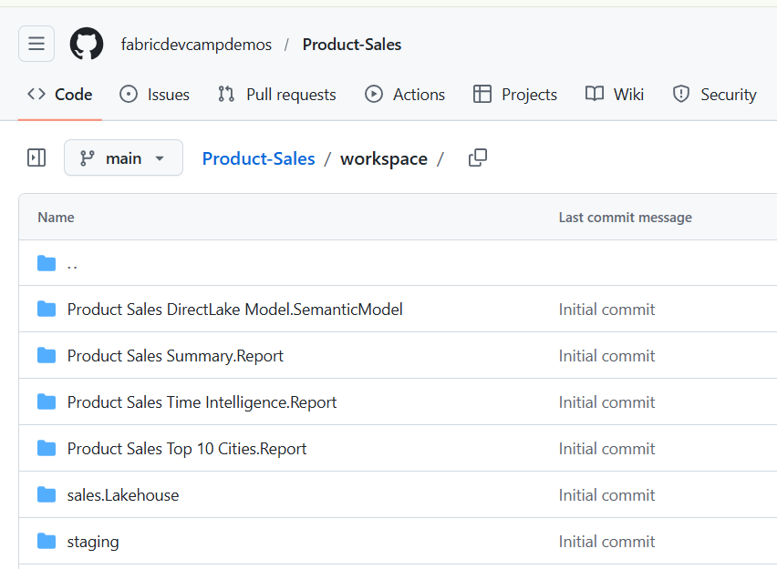
Plan the GIT repository
Select a GIT provider
Choose between Azure Dev Ops, GitHub and GitHub Enterprise
Adopt a branching strategy to determine what long-lived branches to create
Determine what branch to create and what branch policies to configure on specific branches
Plan on who will be developing workflows in GIT provider to control CI/CD lifecycle
When using Azure Dev Ops, workflows are developed using Azure pipelines
When using GitHub, workflows are developed using GitHub Workflow Actions

Slide 15
Plan the Development Process for Continuous Integration
Feature branches and feature workspaces recommended for development process
Determine what GIT branch will be the integration branch (typically it is either main or dev)
Plan how to create and configure features branches and feature workspaces
Plan on how to manage feature workspace lifecycle (to pool or not to pool)
Plan on how workspace items are edited, committed to GIT and merged using pull requests
Plan on developing workflow to sync dev workspace as changes are merged to integration branch
Development Process (CI)
dev
workspace
sync
feature 1
workspace
Commit to GIT
feature 1
branch
pull request
integration
branch
feature 2
workspace
Commit to GIT
feature 2
branch
pull request

Slide 16
Plan the Release Process for Continuous Deployment
Release process built to deploy updates from integration branch to test and prod
Deploy to test workspace for testing and, once approved, deploy to prod workspace
Choose between several common options for building a release process
Option 1: Build the release process using deployment pipelines
Option 2: Build the release process using GIT synchronization
Option 3: Build the release process using fabric-cicd and GitFlow branching
Option 4: Build the release process using fabric-cicd and release flow branching
Development Process (CI)
Release Process (CD)
Dev
workspace
Test
workspace
Prod
workspace
feature
workspace
feature
branch
dev
branch
test
branch
main
branch
feature
workspace
feature
branch

Slide 17
Creating Project Infrastructure using Terraform

Slide 18
Using Terraform to Create Project Infrastructure
Terraform is open-source tool built on the principles of infrastructure as code (IaC)
IaC pattern based on defining the infrastructure for software project using configuration files
Provides significant benefits over manual setup processes or procedural programming logic
Terraform deployment process is versionable and repeatable
Use Terraform to create resources needed for Fabric CI/CD project environments
Use Terraform to create tenant-level items in Fabric such as workspace, capacities & connections
Use Terraform to create Azure resources such as storage accounts, key vaults & service principals
dev environment
test environment
prod environment
Azure Storage Account
used to store dev data files
Azure Storage Account
used to store test data files
Azure Storage Account
used to store prod data files
Fabric Connection
to Azure storage account for dev
Fabric Connection
to Azure storage account for test
Fabric Connection
to Azure storage account for prod
Fabric Workspace
Fabric Workspace
Fabric Workspace
Fabric capacity (F4)
Fabric capacity (F16)
Fabric capacity (F64)

Slide 19
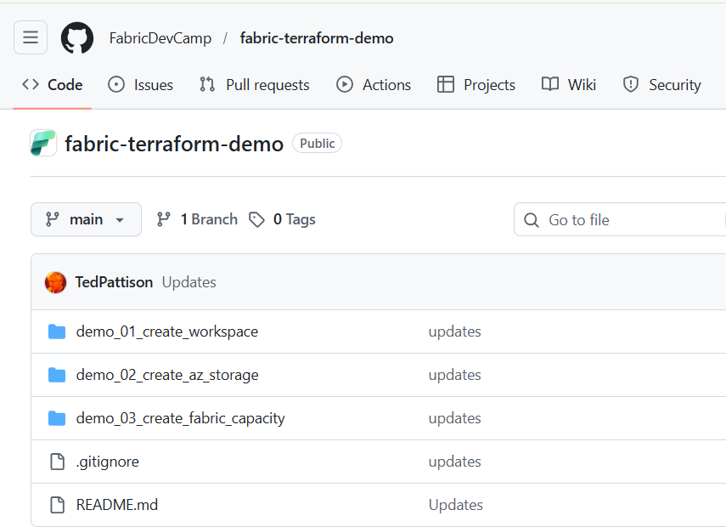
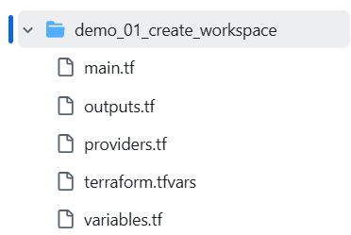
Terraform Demo Files in GitHub
All Terraform demo files available in a GitHub repository
https://github.com/FabricDevCamp/fabric-terraform-demo

Slide 20
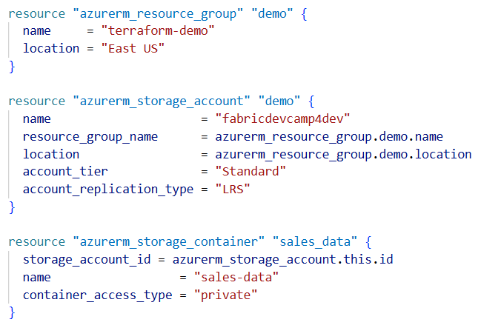
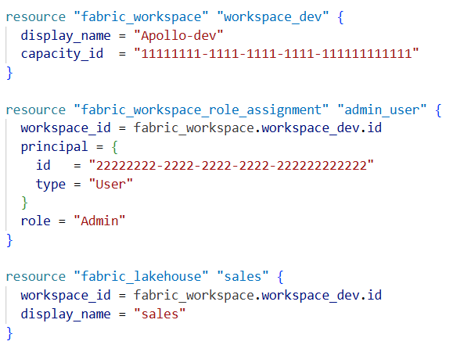
Terraform Providers
Terraform delegates API calls to Terraform providers
azurerm provider used to provision and manage Azure resources
fabric provider used to provision and manage fabric resources
Your Terraform Configuration
Terraform
Terraform provider for Azure (azurerm)
Terraform provider for Fabric (fabric)
Azure REST APIs
Fabric REST APIs

Slide 21
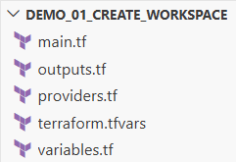
Terraform State File
Steps for using Terraform in a Fabric CI/CD project?
Create a Terraform configuration in in a folder using one or more configuration files
Run init command to download local copy of provider-specific runtime files
Run plan command to review planned lists of the steps required to deploy configuration
Run apply command to start job to create resources needed to match your configuration
Terraform creates state file to track resources properties as they're created or updated
By tracking resource state, Terraform can compare the configuration against the deployment
State file allows Terraform to determine what needs to be created, updated or destroyed
Terraform
deployment
apply
state
file

Slide 22
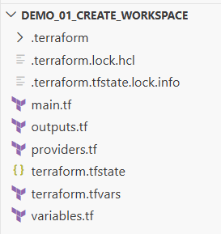
Terraform Configuration Project Files
Common files added to Terraform configurations
providers.tf used to indicate what provider(s) to use
variables.tf used to define variables for coniguration
terraform.tfvars used to assign variable values
main.tf used to provision and manage resources
outputs.tf used to retrieve and display resource properties
.terraform folder created when you run terraform init command
terraform.tfstate created when you run terraform apply command

Slide 23
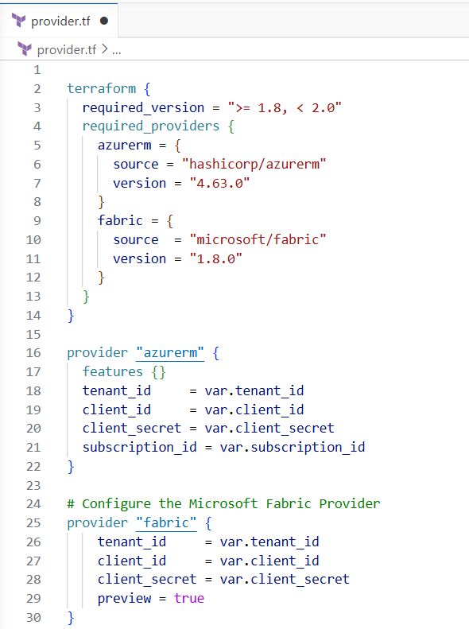
Authenticating as a Service Principal
With Terraform, you can set service principal credentials at provider level
Include tenant_id, client_id and client_secret to authenticate using client credential flow
Also possible to authenticate as managed identity for production scenarios
When creating Azure resources, you also need to supply Azure subscription_id

Slide 24
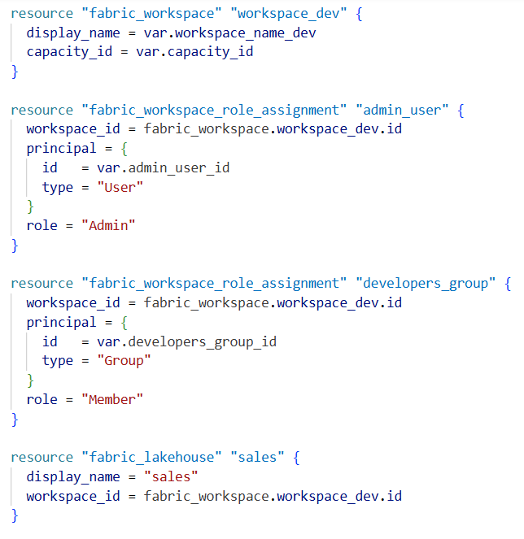
Creating a Fabric Workspace
Use fabric_workspace resource to create new workspace
You must provide values for display_name and capacity_id
Add workspace role assignments using fabric_workspace_role_assignment resource
Also possible to add workspace items such as lakehouse using fabric_lakehouse resource

Slide 25
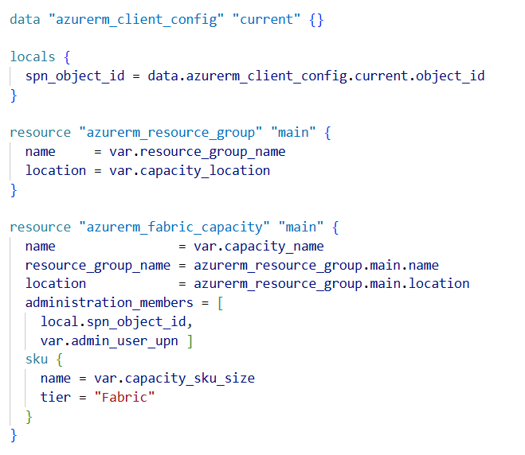
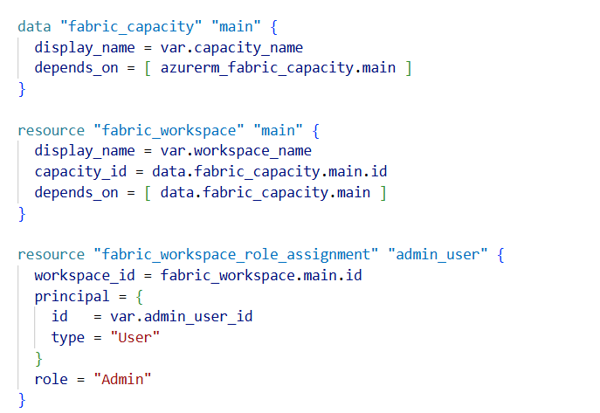
Create a Fabric Capacity
Fabric capacity created using azurerm_fabric_capacity resource
You must first create Azure resource group in which to create new capacity
You must provide valid capacity values for name and location
Creating new workspace using new capacity requires fabric_capacity datasource to retrieve capacity id

Slide 26
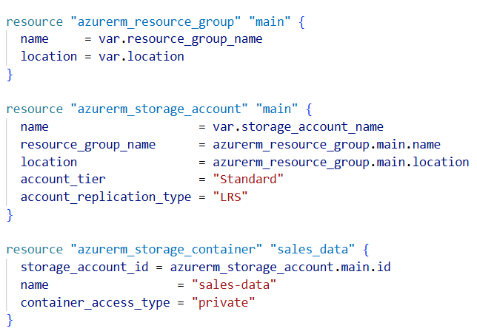
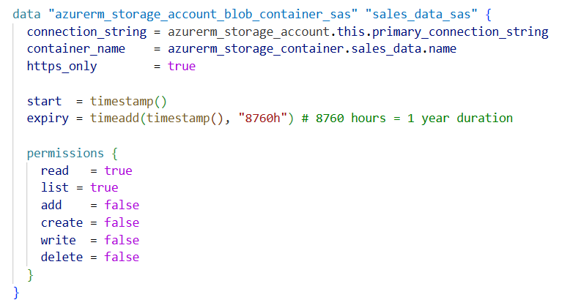
Creating an Azure Storage Account
Create Azure storage account using azurerm_storage_account resource
You must create Azure resource group in which to create new Azure storage account
You must provide valid values for account_tier and account_replication_type
This sample also demonstrates adding a storage container and generating a SaS token

Slide 27
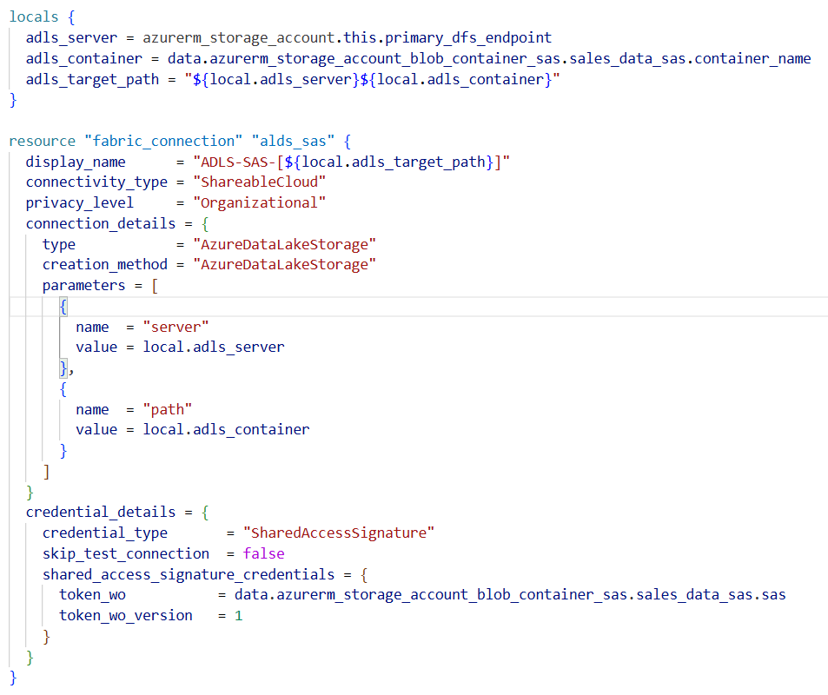
Creating ADLS Gen2 Connections
Fabric connections can be created using fabric_connection resource
Connection display_name must be unique across all cloud connections within Entra Id tenant
connection_details includes connector-specific settings for type, creation_method and parameters
credential_details include credential_type and credentials specific to that credential type

Slide 28
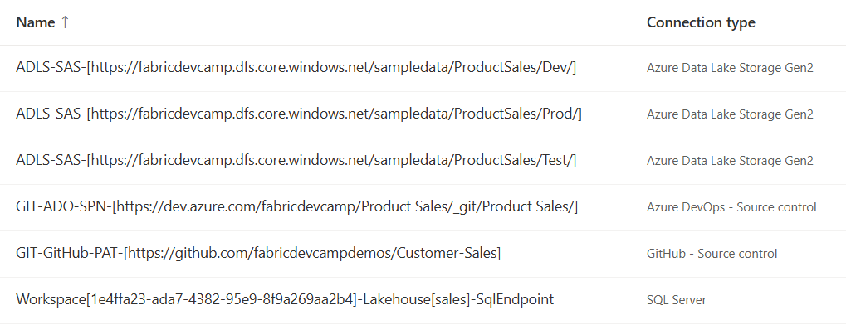
Managing Connections in Fabric
Tenant-level scope makes it harder to manage connections than workspace items
Some connections are designed to be shared across workspaces
Some connections are only intended for use within a single workspace
Terraform provides easy way to track connections and manage their lifecycle
Adopting connection naming conventions assists maintenance, reuse and readability
Create display name using pattern such as [connector]-[credential-type]-[location]
Adding workspace Id into display name used to indicate connection is only used in one workspace

Slide 29
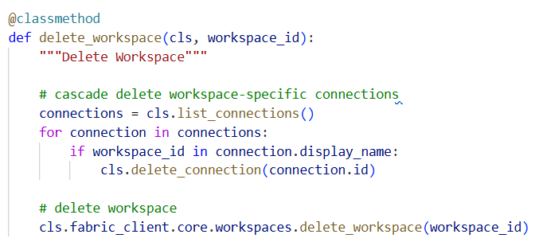
Cleanup of Workspace-specific Connection
When you delete a workspace…
You can clean up by cascade deleting workspace-specific connections

Slide 30
Building a Development Process

Slide 31
Build the Development Process for Continuous Integration
Steps in building the development process
Get the solution up and running in the dev workspace
Create variable library to parameterize environment-specific settings
Create and configure a GIT repository
Connect the dev workspace to GIT integration branch
Create feature branches and feature workspaces
Engage in development to create and update workspace items
Create pull requests to merges changes to the integration branch

Slide 32
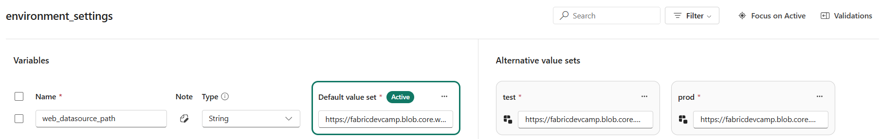
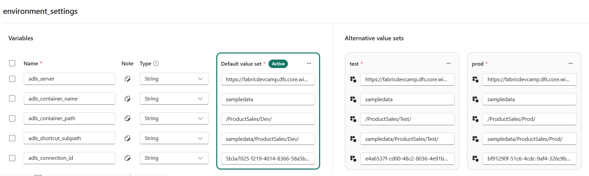
Creating a Variable Library for Parameterization
Example 1 - parameterizing a datasource URL for a notebook
Variable library contains single variable name web_datasource_url
Variable library extended with two additional value sets named test and prod
Example 2 - parameterizing a ADLS Gen2 connection for shortcuts or pipelines
Contains variables with datasource paths as well as variable for connection_id

Slide 33
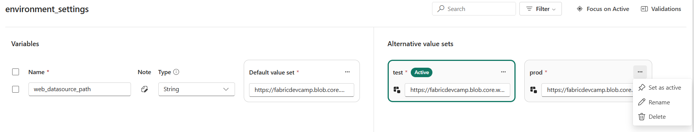
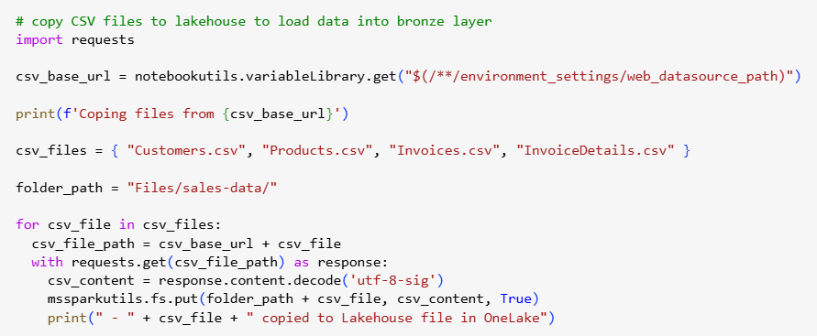
Using variables in a notebook
Set active value set to match environment of target workspace
Notebook uses expression syntax of $(/**/ {LIBRARY_NAME} / {VARIABLE_NAME} ) to read variable value

Slide 34
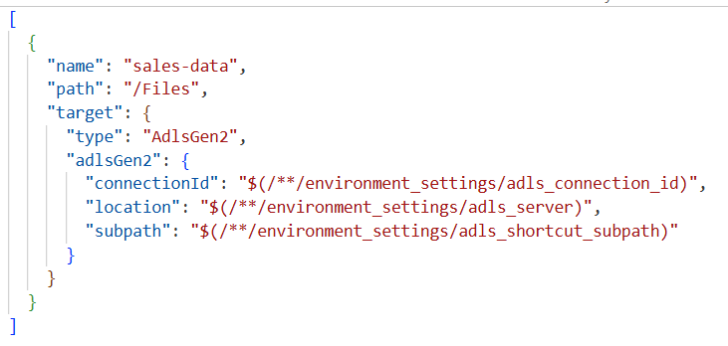
Using variables in a ADLS Gen2 shortcut
Using variables to create ADLS Gen2 shortcut
Variables required for ADLS server location, sub path and connection id
Shortcut can be created by hand or by using Create Shortcut API using variable expression syntax

Slide 35
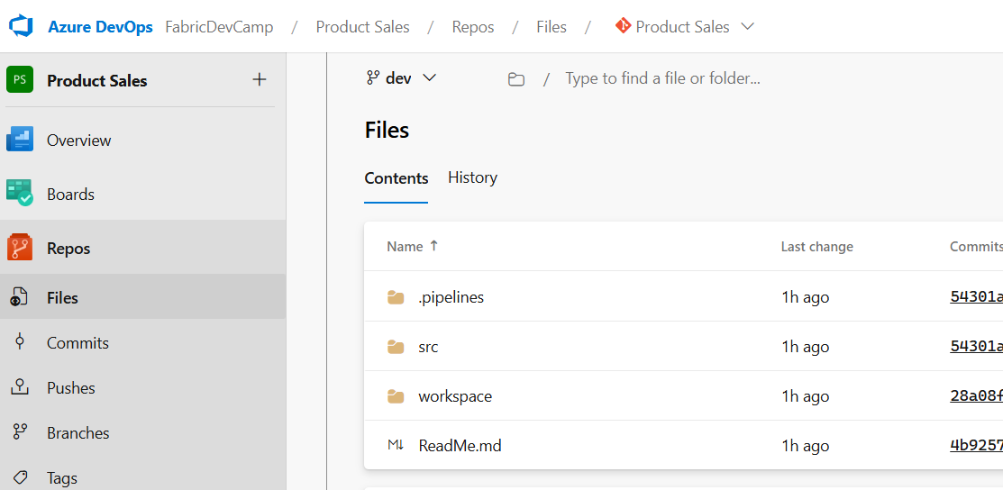
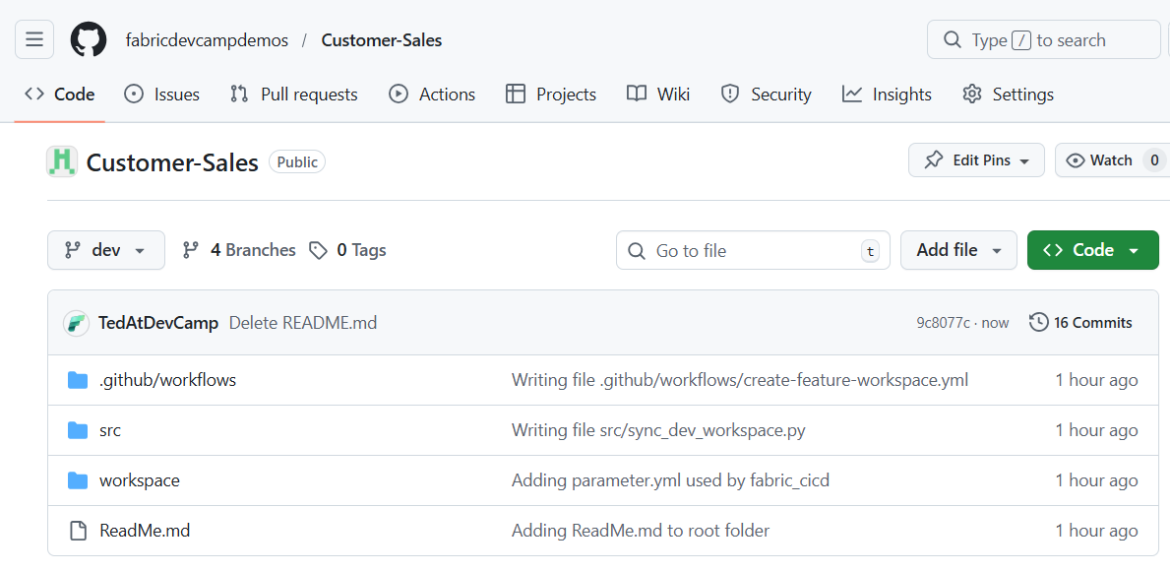
Create a GIT Repository
Select a GIT provider supported by Fabric
Choose Azure DevOps or GitHub or GitHub Enterprise
Create long-lived branches such as main, test and dev
Azure Dev Ops Project and Repository
GitHub Repository

Slide 36
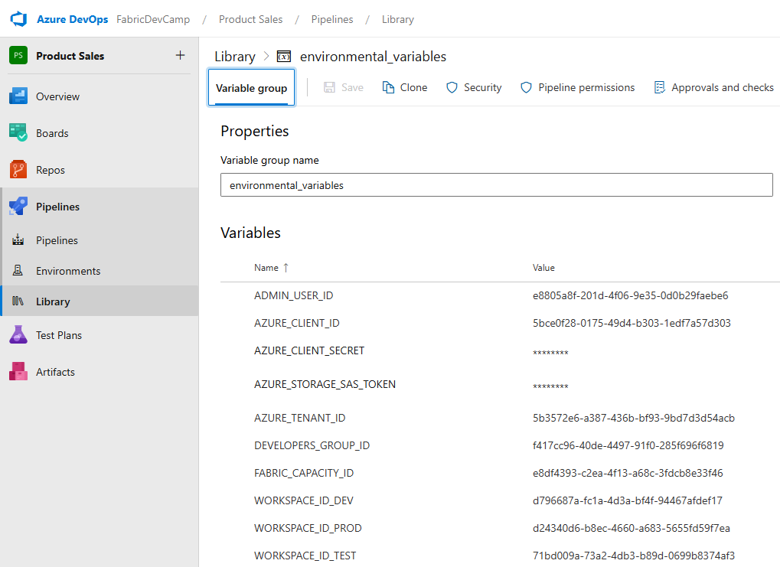
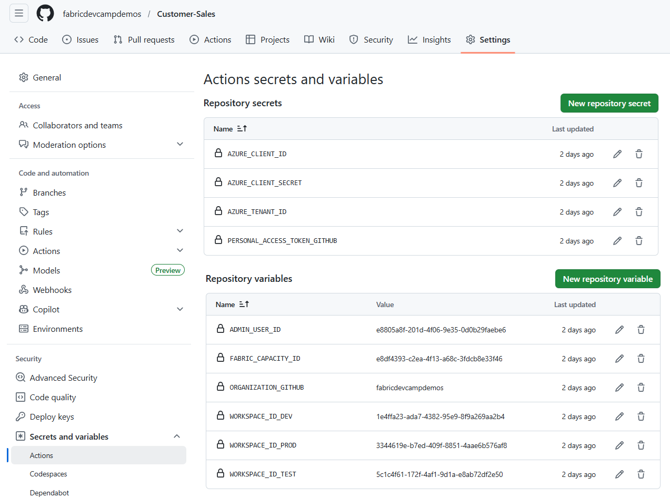
Configure GIT Repository with Secrets and Variables
Add secrets and variables that will be used by workflow code
Add secrets for authentication credentials
Add variables for the Ids of workspaces, capacities, users and Entra Id groups
Azure Dev Ops requires adding library to project to add variables and secrets
Azure Dev Ops Library
GitHub Repository secretes and variables

Slide 37
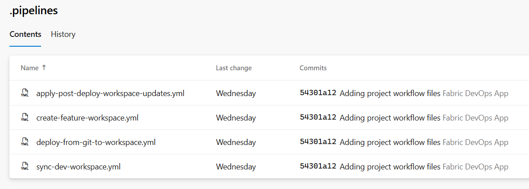
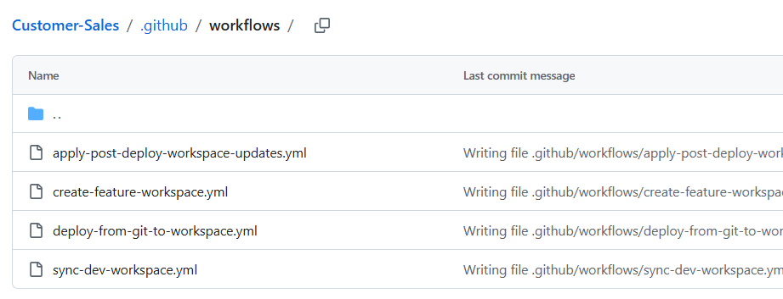
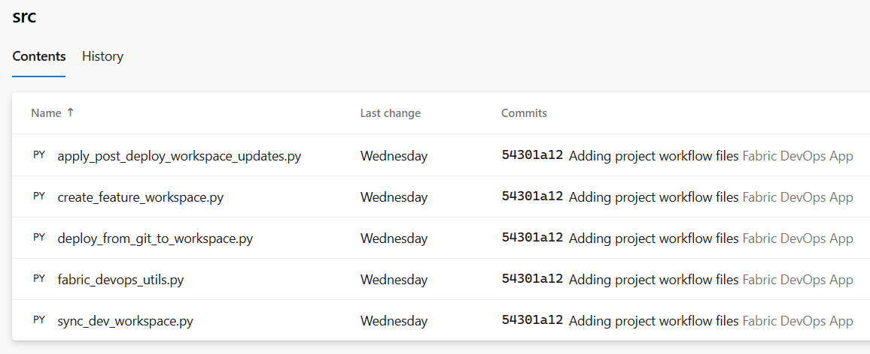
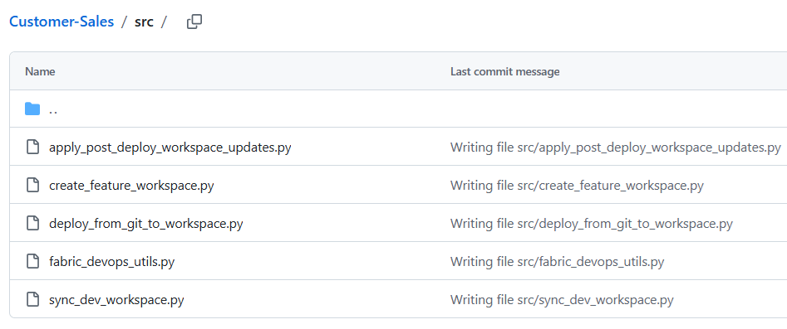
Extend the GIT Repository with Workflows
Develop workflow logic to control Fabric CI/CD lifecycles
With Azure Dev Ops, develop workflows using Azure pipelines
With GitHub, develop workflows using GitHub Workflow Actions
Azure Pipelines
GitHub Workflow Actions

Slide 38
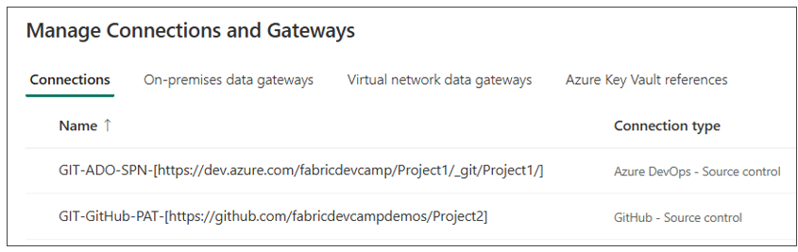
Create a GIT Source Control Connection
Fabric provides GIT source control connectors for creating GIT connections
Azure Dev Ops - Source control connection can be created using service principal credentials
GitHub - Source control connection must be configured using a personal access token (PAT)
Source control connection configured with path to repository - not to specific branch
You can reuse a source control connection to connect many workspaces to branches in same repo
BE AWARE: connection credential identity will appear in GIT provider as the committer of changes

Slide 39
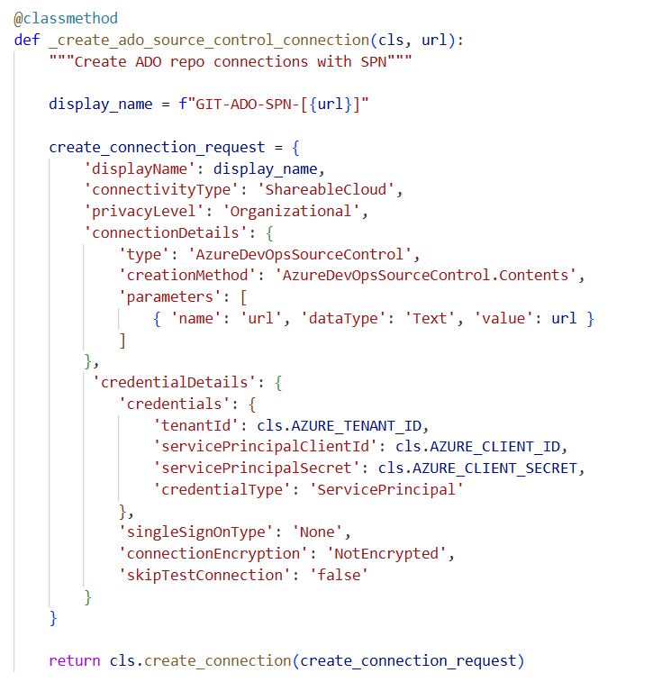
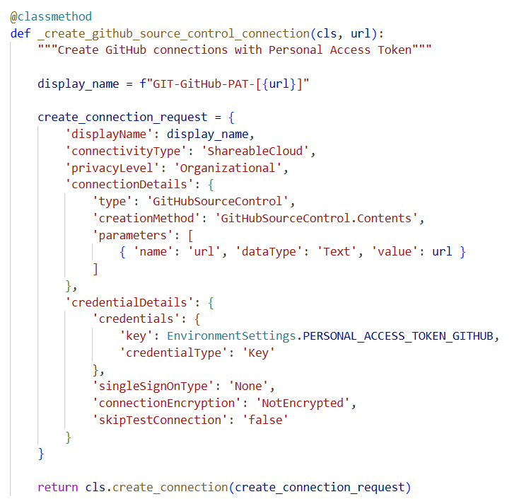
Creating GIT Source Control Connections using APIs
Create a connection to an Azzure Dev Ops repository
Create a connection to a GitHub repository

Slide 40
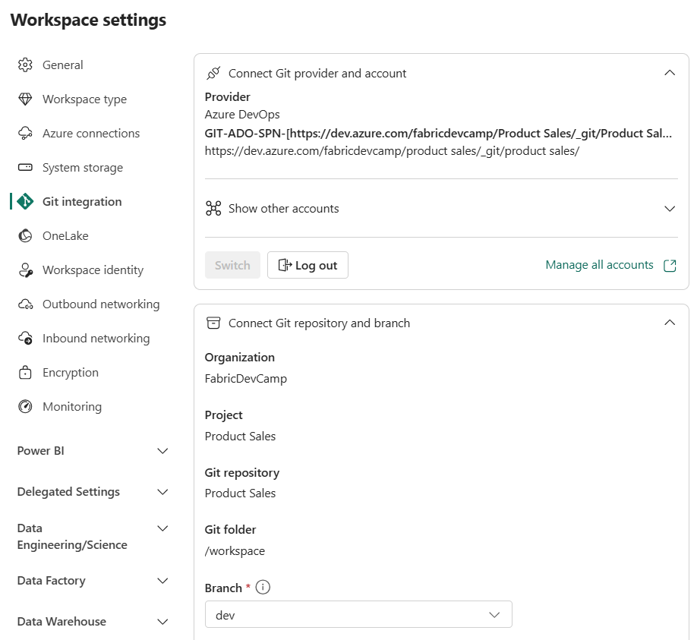
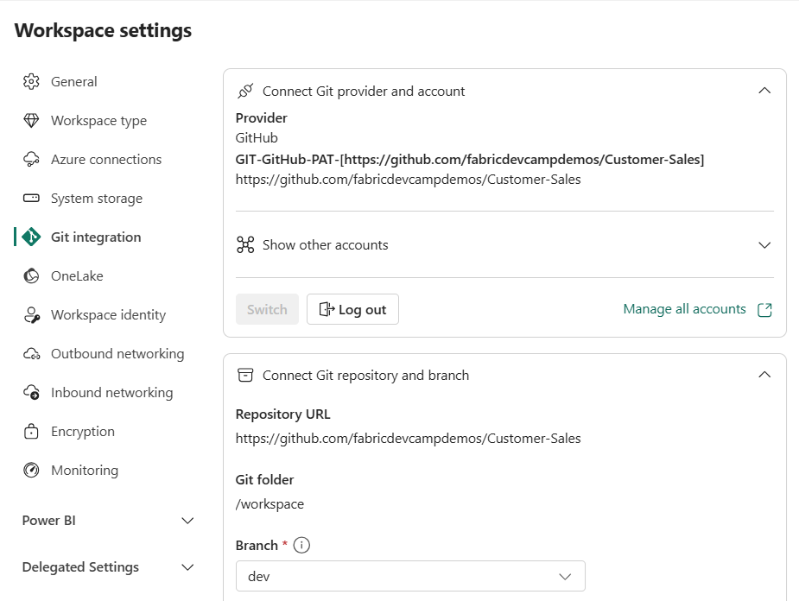
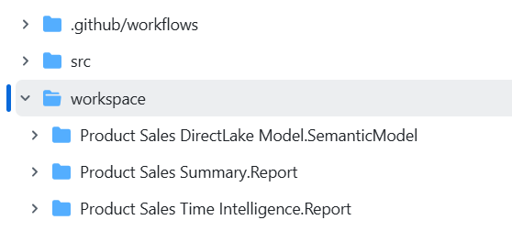
Connect the dev workspace to integration branch
Fabric GIT integration enabled at workspace scope
Connect dev workspace to integration branch using GIT source control connection
Configure GIT folder setting so item definition files are not added to root folder

Slide 41
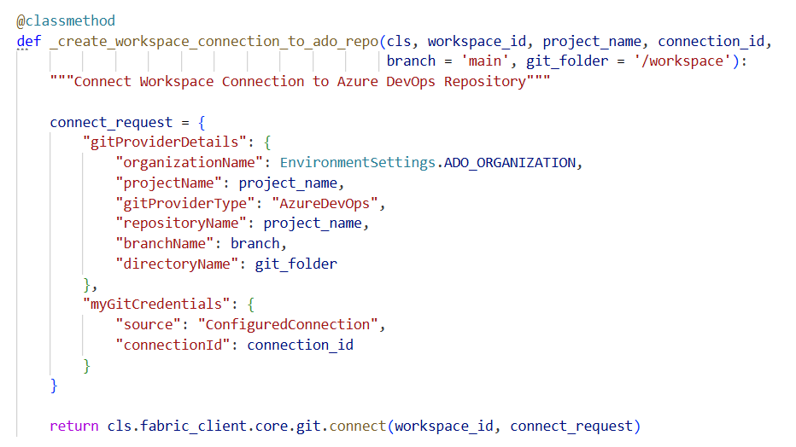

Connecting a Workspace to GIT Branch using APIs
Fabric REST APIs provides Connect API to connect workspace to a specific GIT branch
Connect request requires org name, provider type, repo name and branch name and git folder
Connecting to ADO repository requires project name in addition to repo name
myGitCredentials setting requires source of ConfiguredConnection and connection id
CAVEAT: GIT folder referenced with directoryName setting must already exist or error occurs

Slide 42
Flows for Feature Branches and Feature Workspaces
Connect dev to integration branch and run Commit to GIT action in one-time operation
This creates the single source of truth for a Fabric CI/CD project
Create feature workspace and then initialize it using Update from GIT operation
Additional work usually required to prepare feature workspace for development
After updating workspace items, comment changes to GIT and create pull request
Workspace item changes committed to feature branch & merged to integration branch
dev
workspace
integration
branch
Commit to GIT
integration
branch
feature
branch
feature
workspace
Create Branch
Update from GIT
feature
workspace
feature
branch
integration
branch
Commit to GIT
Pull Request

Slide 43



Creating Feature Workspace by Hand
You can create and configure feature workspaces by hand or by using APIs

Slide 44
Edit in Workspace versus Edit Locally using Client Tools
Development flow #1: Apply edits to workspace items
Development flow #2: Apply edits in local repo clone to item definitions using client tools
Clone repo to developer machine and edit item definitions locally using a client tool
Local changes pushed to remote repo synced to feature workspace using Update from GIT action
feature
workspace
feature
branch
integration
branch
Commit to GIT
Pull Request
Developer Desktop
Cloud
VS Code
Power BI
Desktop
feature
workspace
GIT Sync
local clone
of branch
Push Changes
feature
branch
Pull Request
integration
branch
clone

Slide 45


Auto-bind behavior
Some workspace item types self-manage their relations to other workspace items
Pipelines support auto-binding behavior
Notebooks have not supported auto-binding behavior in the past - But that is about to change
When you encounter workspace item types that do not support auto-binding…
required to run a post-sync job script to correctly reestablish relations to other workspace items.
Adding auto-binding support to notebook

Slide 46
Running Jobs After Update-from-GIT Operations
After Update from GIT completes, workspace items often require additional configuration
Run ETL jobs using notebooks, pipelines, copy jobs or dataflows
Updates required for workspace items that do not support auto-binding
Updates required for workspace items that do not support variable libraries
Jobs run after Update from GIT operation fall into two categories
Post-deploy jobs run only once after an empty workspace is first initialized
Post-sync jobs run each time after an Update from GIT operation completes on a workspace
Scenario 1: creating a feature workspace
Scenario 2: sync dev workspace after pull request
feature
workspace
dev
workspace
feature
workspace
dev
workspace
Update
from
GIT
Commit
to
GIT
Commit
to
GIT
Update
from
GIT
feature
branch
Create Branch
integration
branch
feature
branch
Pull
Request
integration
branch

Slide 47
Post-deploy Jobs versus Post-sync Jobs
Examples of Post-deploy jobs that run only once after workspace is first initialized
Process ETL jobs by running notebooks, pipelines, copy jobs, dataflows, etc.
Call Refresh Sql Endpoint Metadata API
Create connections and bind them to semantic models
Examples of Post-sync jobs that run each time after an Update from GIT operation
Rebind a notebook to a lakehouse
Update external datasource path for semantic model with environment-specific settings
Update datasource for DirectLake semantic model to reference lakehouse in same workspace

Slide 48

Creating Feature Workspace using APIs
You can write scripts to create and configure feature workspaces
You can prepare workspace for dev work by running ETL jobs and connecting semantic models
You can deal with environment-specific settings that have been persisted into GIT branch

Slide 49


Adding Workflow To Keep the dev Workspace in Sync
Workflow created with trigger to run upon pull request completion
Workflow runs after changes have been merged to integration branch
Workflow starts by running Update from GIT operation

Slide 50
Building a Release Process

Slide 51
Building th Release Process for Continuous Intergation
Release process built to deploy updates from integration branch to test and prod
Deploy to test workspace for testing and, once approved, deploy to prod workspace
Choose between several common options for building a release process
Option 1: Build the release process using deployment pipelines
Option 2: Build the release process using GIT synchronization
Option 3: Build the release process using fabric-cicd and GitFlow branching
Option 4: Build the release process using fabric-cicd and release flow branching
Development Process (CI)
Release Process (CD)
Dev
workspace
Test
workspace
?
feature
workspace
feature
branch
integration
branch
Prod
workspace
feature
workspace
feature
branch

Slide 52
Option 1: Release Process using Deployment Pipelines
Use GIT integration for CI and deployment pipeline for CD
main branch serves as integration branch
dev workspace kept in sync with main branch using automated Update from GIT action
Workspace item changes moves across workspaces using deployment pipeline Deploy action
Fabric Deployment Pipeline
dev
workspace
DEPLOY
test
workspace
DEPLOY
prod
workspace
Update
from GIT
main
branch

Slide 53
Option 2: Release Process using GIT Sync
Use GIT synchronization to publish changes to test and prod
dev branch serves as integration branch
All workspace kept in sync with underlying branch using automated Update from GIT action
Workspace item changes moved across branches using pull request
dev
workspace
test
workspace
prod
workspace
Update
from GIT
Update
from GIT
Update
from GIT
dev
branch
test
branch
main
branch
Pull Request
Pull Request

Slide 54

The fabric-cicd Python Library
fabric-cicd library provides ease-of-use deployment wrapper around Fabric REST APIs
Code-first designed allows for deployment from item definitions folder to target workspace
Built-in code automatically determines & reestablishes dependencies between workspace items
Provides parameterization to deal with environment-specific settings persisted to GIT branch
Provides best practice for building API-driven release process

Slide 55


Configuration-based Deployment
Using configuration-based deployment is recommended with fabric-cicd
You must create YAML file (e.g. deploy.yml) containing basic deployment information
Deployment configures environments such as dev, test and prod as deployment targets
fabric-cicd automatically activates value set in variable library if name matches environment name
Older style of calling publish_all_items still supported for backwards compatibility

Slide 56
Option 3: Release Process using fabric-cicd and GitFlow
Use fabric-cicd library to deploy changes to test and prod
dev branch serves as integration branch
dev workspace kept in sync with underlying branch using automated Update from GIT action
test and prod workspaces kept in sync with underlying branch using fabric-cicd library
Dev
workspace
Test
workspace
Prod
workspace
Update
from GIT
fabric-cicd
fabric-cicd
dev
branch
test
branch
main
branch
Pull Request
Pull Request

Slide 57



Deploy from GIT to Workspace Workflow with ADO

Slide 58


Parameterization with fabric-cicd
Parameterization allows updates to item definition files on the fly
Parameterization required to deal with environment-specific settings committed to GIT
Parameterization enabled by adding parameter.yml file to root folder
Parameterization used to update item definition files using substitution patterns (e.g. find-replace)

Slide 59


Using RegEx and Dynamic Variables in Parameterization
The problem: you need to update the default lakehouse id and the workspace id
The solution is based on regex expressions and dynamic variables ($workspace.$id)

Slide 60

Connecting Semantic Model to Lakehouse SQL Endpoint

Slide 61
Option 4: Release Process using fabric-cicd and release flow
Option 4 is built on trunk-based development approach
main branch serves as integration branch with dev workspace kept in sync using Update from GIT
Release process does not include log-lived branches for test and prod
Release process involves creating new test branch for each release
Upon creation, test branch deployed to test workspace using fabric-cicd
Once test branch approved, prod branch created from test branch and deployed with fabric-cicd
Creating of test 1.x and prod 1.x branches creates valuable release history
Release History
Dev
workspace
Test
workspace
Prod
workspace
test 1.0
prod 1.0
test 1.1
prod 1.1
Update
from GIT
fabric-cicd
fabric-cicd
test 1.2
test 1.3
test 1.3
main
branch
test 1.x
branch
prod 1.x
branch
test 2.0
test 2.0
Create Request
Create Branch

Slide 62

Workflows in Action

Slide 63
Session Summary
Essential Concepts and Capabilities
Planning the Fabric CI/CD Project Lifecycle
Creating Project Infrastructure using Terraform
Building a Development Process
Building a Release Process

